Slide 1
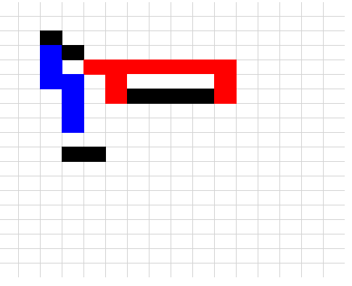
Puzzle Height [slider] Puzzle Width [slider]
Number of Colors [slider]
Build Blank Puzzle
Save
Load
Design File Name: ________________________
Puzzle Design
Pieces Design

Slide 2
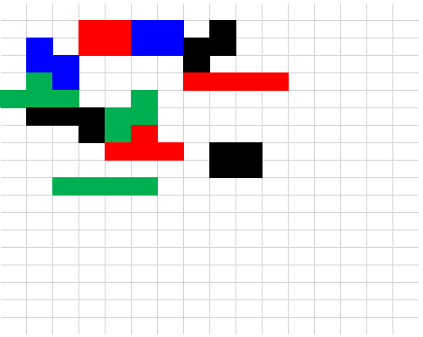
Puzzle Height [slider] Puzzle Width [slider]
Number of Colors [slider]
Build Blank Puzzle
Save
Load
Design File Name: ________________________
Puzzle Design
Pieces Design
[This will be an expandable selector that lists each created piece]

